Slide 1
BU Emergency Response App

Slide 2
Q1.5 BU Emergency Response App
To further ensure the safety of BU freshmen, a safety app with multiple functions can be developed. The app will use the phone's GPS, accelerometer, gyroscope and other sensors to provide accurate real-time safety tips and alarm functions. We designed 5 specific functions to further ensure the safety of BU freshmen.

Slide 3
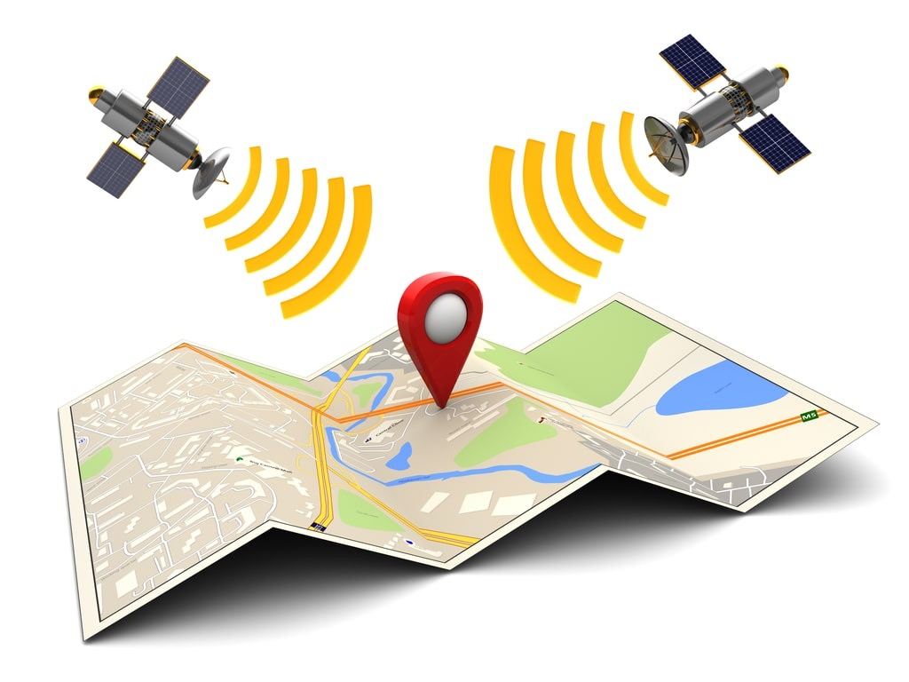
Function1: Real-time location sharing and safe area display
The app tracks the user's real-time location through GPS to help them understand the safety conditions around them. There is a safety map in the app that shows the safe and dangerous areas in and around the campus. This data will be updated in real time through user feedback and crowdsourced data. Users can use the app to quickly see which areas are potentially dangerous (such as crime-prone areas or traffic accident-prone areas).

Slide 4

Function2: Emergency help function
If users feel in danger, they can click the "Emergency Help" button in the app to immediately send their location information to the campus security department or preset emergency contacts. In order to respond to critical situations, the help button is designed to be a one-click operation to save time.
The app also allows users to upload real-time photos or videos to better describe the situation on the scene (because some situations may not be suitable for operating mobile phones, photo or video upload function is optional).

Slide 5

Function3: Dangerous Area Alerts and Event Notifications
The app can use crowdsourced real-time data and archived information to push safety alerts about dangerous events or areas around you. For example, if there have been reports of accidents in a certain area or there have been recent public safety issues, the app will push notifications to warn users to avoid the area.
Users can also manually report dangerous or unsafe situations they encounter, providing real-time safety information to other users.

Slide 6
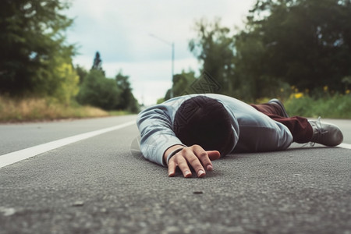
Function4: Automatic detection of dangerous situations
The app can automatically detect whether the user has encountered an accident (such as a fall or severe vibration) through sensors such as accelerometers and gyroscopes.
If an abnormal situation is detected and the user fails to respond within a specified time, the app will automatically send a distress signal to emergency contacts or campus security.

Slide 7

Function5: Offline mode and emergency contact
Since users may encounter danger when the network signal is poor, the app can also provide an offline mode. In this mode, the app will continue to provide safety tips based on stored maps and known dangerous area information. At the same time, the emergency rescue function will prioritize trying to send location and distress information via SMS.
Through the integration of these features, this app can not only help BU freshmen quickly adapt to unfamiliar environments, but also effectively ensure their safety and avoid potential dangers.

